Slide 1

Project Report on
FLIGHT PRICE PREDICTION
Submitted by: Purnima Pati

Slide 2
Introduction and problem statement
What is the best time to buy a flight ticket? The airline implements dynamic pricing for the flight ticket. According to the survey, flight ticket prices change during the morning and evening time of the day. Also, it changes with the holidays or festival season. There are several different factors on which the price of the flight ticket depends. The seller has information about all the factors, but buyers are able to access limited information only which is not enough to predict the airfare prices. Considering the features such as departure time, the number of days left for departure and time of the day it will give the best time to buy the ticket. The purpose of the paper is to study the factors which influence the fluctuations in the airfare prices and how they are related to the change in the prices. Then using this information, build a system that can help buyers whether to buy a ticket or not
Anyone who has booked a flight ticket knows how unexpectedly the prices vary. The cheapest available ticket on a given flight gets more and less expensive over time. This usually happens as an attempt to maximize revenue based on - 1. Time of purchase patterns (making sure last-minute purchases are expensive) 2. Keeping the flight as full as they want it (raising prices on a flight which is filling up in order to reduce sales and hold back inventory for those expensive last-minute expensive purchases) So, you have to work on a project where you collect data of flight fares with other features and work to make a model to predict fares of flights.

Slide 3
Data Analysis
After cleaning the data, you have to do some analysis on the data. Do airfares change frequently? Do they move in small increments or in large jumps? Do they tend to go up or down over time? What is the best time to buy so that the consumer can save the most by taking the least risk? Does price increase as we get near to departure date? Is Indigo cheaper than Jet Airways? Are morning flights expensive?
Model Building
After collecting the data, you need to build a machine learning model. Before model building do all data pre-processing steps. Try different models with different hyper parameters and select the best model.
Follow the complete life cycle of data science. Include all the steps like
1. Data Cleaning
2. Exploratory Data Analysis
3. Data Pre-processing
4. Model Building
5. Model Evaluation
6. Selecting the best model

Slide 4
Let’s look at the need of flight price prediction
Flight ticket prices can be something hard to guess, today we might see a price, check out the price of the same flight tomorrow, it will be a different story. We might have often heard travelers saying that flight ticket prices are so unpredictable. As data scientists, we are gonna prove that given the right data anything can be predicted. Here you will be provided with prices of flight tickets for various airlines.
Airline companies use complex algorithms to calculate flight prices given various conditions present at that particular time. These methods take financial, marketing, and various social factors into account to predict flight prices.
Nowadays, the number of people using flights has increased significantly. It is difficult for airlines to maintain prices since prices change dynamically due to different conditions. That’s why we will try to use machine learning to solve this problem. This can help airlines by predicting what prices they can maintain. It can also help customers to predict future flight prices and plan their journey accordingly.

Slide 5
Data Collection / EDA / Data Cleaning
The collection of data is the most important aspect of this project. There are various sources of the data on different websites which are used to train the models. Websites give information about the multiple routes, times, airlines and fare. Various sources from API’s to consumer travel websites are available for data scraping. In this section details of the various sources and parameters that are collected are discussed. To implement this data is collected from a website “Makemytrip.com” and python is used for the implementation of the models and collection of the data.
Collection of data The script extracts the information from the website and creates a CSV file as output. This file contains the information with features and its details[13]. Now an important aspect is to select the features that might be needed for the flight prediction algorithm. Output collected from the website contains numerous variable for each flight but not all are required, so only the following feature is considered.
Origin , Destination , Departure Date , Departure Time, Arrival Time, Total Fare Airways Taken
In this study, the focus is only on minimizing the airfare charges

Slide 6
EDA / Data Cleaning continue…..
All the collected data needed a lot of work so after the collection of data, it is needed to be clean and prepare according to the model requirements. All the unnecessary data is removed like duplicates and null values. In all machine learning this technology, this is the most important and time-consuming step. Various statistical techniques and logic built-in python are used to clean and prepare the data. For example, the price was character type, not an integer.
Data preparation is followed by analyzing the data, uncovering the hidden trends and then applying various machine learning models. Also, some features can be calculated from the existing feature. Days to departure can be obtained by calculating the difference between the departure date and the date on which data is taken. This parameter is considered to be within 45 days. Also, the day of departure plays an important role in whether it is holiday or weekday. Intuitively the flights scheduled during weekends have a more price compared to the flights on Wednesday or Thursday. Similarly, time also seems to play an important factor. So the time is been divided into four categories: Morning, afternoon, evening, nigh

Slide 7
Modelling part
To develop the model for the flight price prediction, many conventional machine learning algorithms are evaluated. They are as follows
: Linear regression, Decision tree, Random Forest Algorithm], K-Nearest neighbors, Multilayer Perceptron, Support Vector Machine (SVM) and Gradient Boosting. All these models are implemented in the scikit learn. To evaluate the performance of this model, certain parameters are considered. They are as follows:
R-squared value, Mean Absolute Error (MAE) and Mean Squared Error (MSE).
I have used Random Forest for Flight price prediction
Random Forest It is a supervised learning algorithm. The benefit of the random forest is, it very well may be utilized for both characterization and relapse issue which structure most of current machine learning framework. Random forest forms numerous decision trees, what’s more, adds them together to get an increasingly exact and stable expectation. Random Forest has nearly the equivalent parameters as a decision tree or a stowing classifier model. It is very simple to discover the significance of each element on the expectation when contrasted with others in this calculation

Slide 8
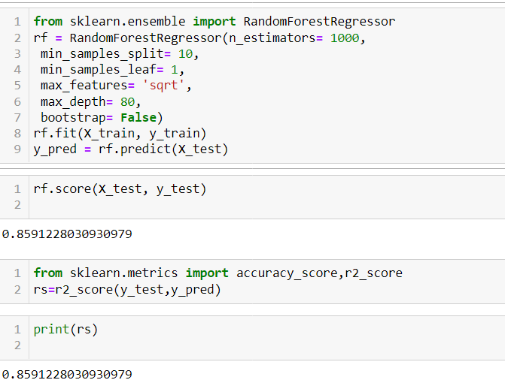
Modelling part Continue….

Slide 9
Accuracy --> 89.04002619286328
In [ ]:
Conclusion
In the proposed paper the overall survey for the dynamic price changes in the flight tickets is presented. this gives the information about the highs and lows in the airfares according to the days, weekend and time of the day that is morning, evening and night , also the machine learning models in the computational intelligence field that are evaluated before on different datasets are studied. their accuracy and performances are evaluated and compared in order to get better result. For the prediction of the ticket prices perfectly different prediction models are tested for the better prediction accuracy. As the pricing models of the company are developed in order to maximize the revenue management. So to get result with maximum accuracy regression analysis is used. From the studies , the feature that influences the prices of the ticket are to be considered. In future the details about number of available seats can improve the performance of the model

